Slide 1
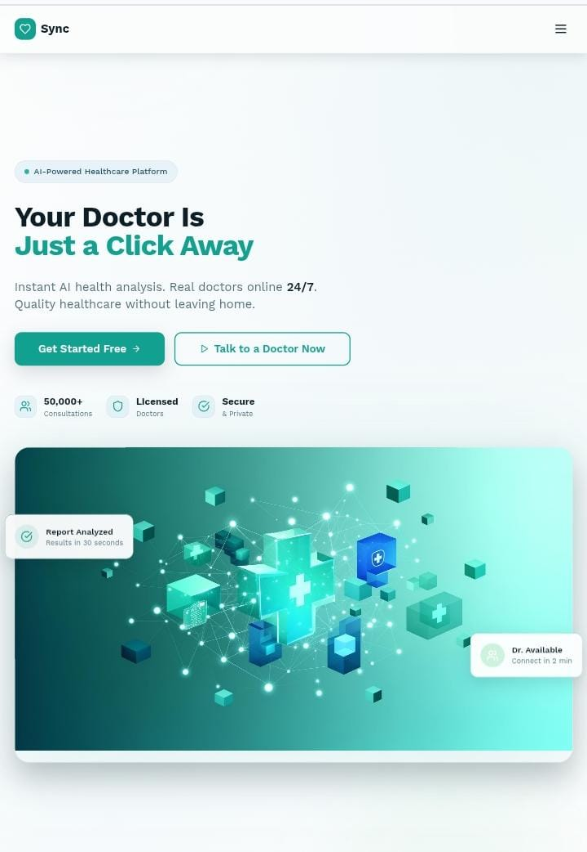
BRIDGING HEALTHCARE GAPS WITH AI
FINAL YEAR PROJECT
BHG-AI-(25-26)

Slide 2
CONTENTS OF THIS PRESENTATION
OBJECTIVES OF THE PROJECT
EXISTING PLATFROMS VS HEALTHBRIDGE.AI
CORE FEATURES OF OUR PROJECT
AI HEALTH ASSISTANT
MEDICAL REPORT ANALYSIS
TELECONSULTATION SYSTEM
DOCTOR DIRECTORY AND MATCHING
TECHNOLOGY STACK
IMPLEMENTATION CHALLENGES AND SOLUTIONS
SECURITY AND PRIVACY MEASURES
RESULTS AND IMPACT : EXPECTED OUTCOMES
TECHNICAL METRICS
FUTURE ENHANCEMENTS
CONCLUSIONS

Slide 3
GROUP MEMBERS
Aqsa Shahzad BSCS51F22S028 Team Lead
Sehrish Akram BSCS51F22S019 Team Member
Farwa Eiman Arif BSCS51F22S014 Team Member
Ayesha BSCS51F21R036 Team Member
Supervisors:
Dr. Hafiz Muhammad Faisal Shahzad
Mr. Aamir Zia
Project Manager:
Prof. Dr. Muhammad Ilyas

Slide 4
PROBLEM STATEMENT
The Healthcare Crisis in Pakistan:
Limited access to medical professionals, especially in rural areas·
Long waiting times at hospitals·
High consultation costs for underserved populations·
Language barriers and low health literacy.
Healthcare challenge | Statistics | Source/Reference
Critical Doctor Shortage | 1:1000 doctor to patient ratio | PMC, 2023
High out of pocket costs | 60% of health expenses directly paid | JPMA, 2025
Rural access gap | 70% population VS 30% healthcare facilities | World Bank, 2024

Slide 5
PROBLEM STATEMENT Result: 45% of Pakistanis skip medical care due to costs and distance. SOLUTION An AI-powered platform making healthcare accessible, affordable, and understandable.
Healthcare challenge | Statistics | Source/Reference
Low health literacy | Only 38% understand medical instructions | National Health Survey, 2023
Telemedicine lag | <15% providers offer online consultation | Pakistani telehealth, 2024

Slide 6
EXISTING PLATFORMS VS HEALTHBRIDGE.AI
Existing Platforms
1. | 2. | 3.
Oladoc | Marham | Sehat Kahani
Online doctor appointment booking platform. | Telemedicine and online consultations. | Video-based digital healthcare services.
HealthBridge.ai
HealthBridge.ai uses AI to explain medical reports, symptoms, and terms in simple Urdu/English, helping patients understand their health independently before visiting a doctor.

Slide 7
OBJECTIVES OF THE PROJECT
1.
2.
3.
4.
5.
6.
AI Symptom Checker
AI Report Scanner
Video Consultation Platform
Doctor-patient Matching
Simple & Accessible Design
Medicine Tracker & Reminders

Slide 8
CORE FEATURES
AI Health
Assistant
Teleconsultation System
Medical Report Analysis
Doctor Directory & Matching

Slide 9
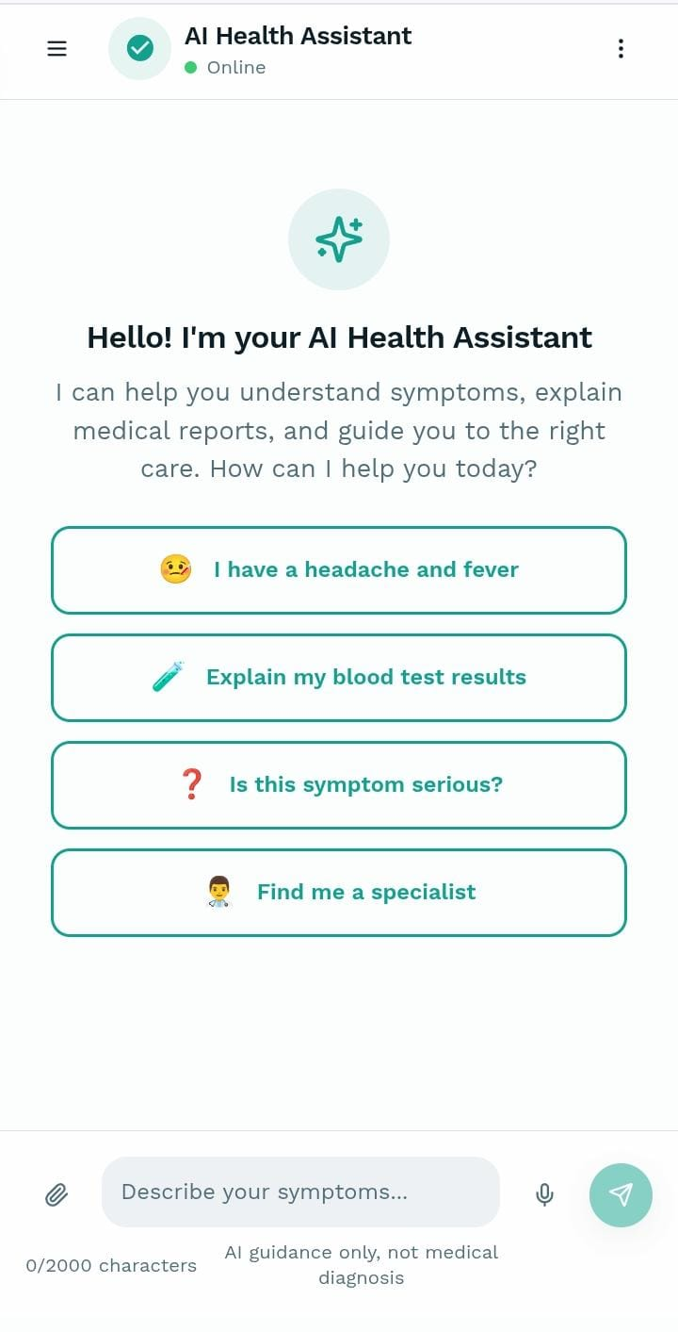
1. AI Health Assistant
Symptom analysis and triage (4 urgency levels)
Bilingual support (English/Urdu)
Context-aware conversations

Slide 10

2. Medical Report Analysis
Upload reports (PDF/JPG/PNG)
OCR text extraction
Plain language explanations

Slide 11
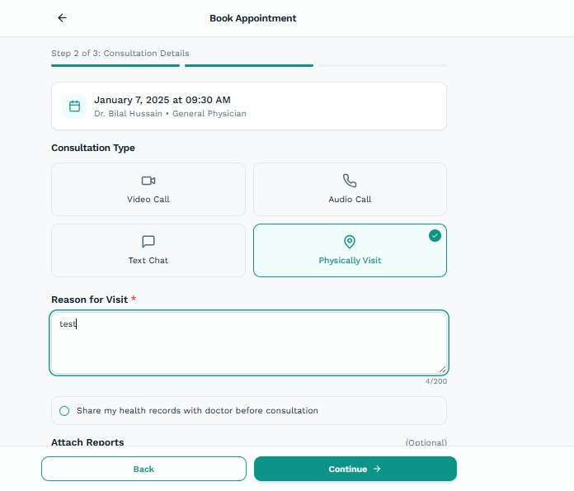
3. Teleconsultation System
Video/audio consultations via WebRTC
Real-time chat during sessions
Appointment booking with reminders

Slide 12
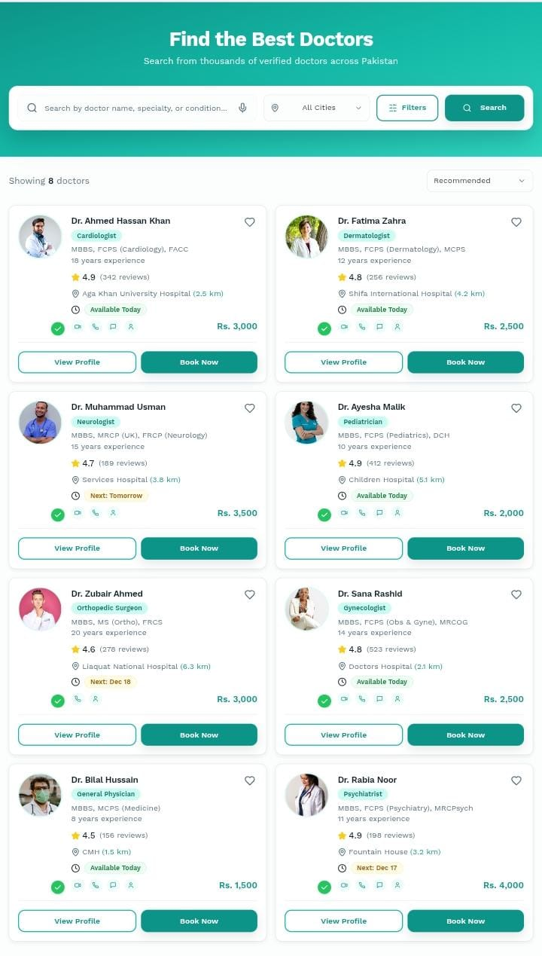
4. Doctor Directory & Matching
Search by specialty, location, availability
Verified doctor profiles
Payment integration (JazzCash, EasyPaisa, Bank transfers)

Slide 13
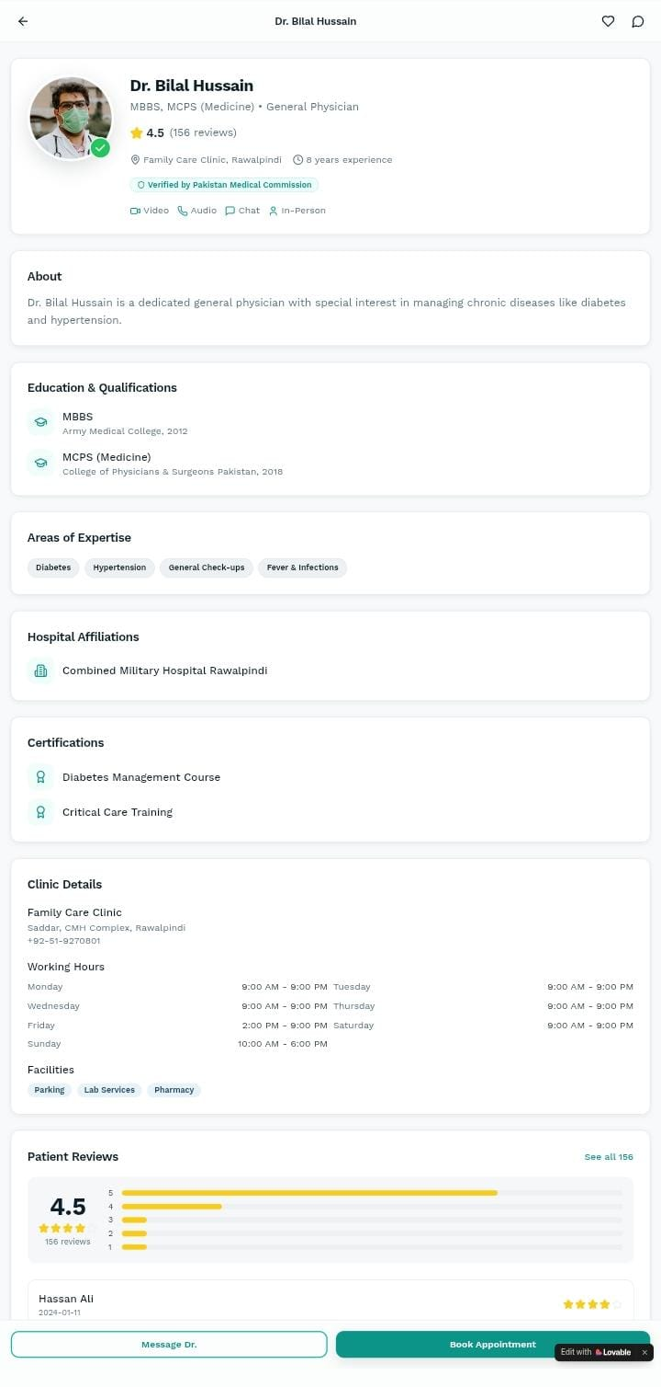
5. Doctor Profile Page
Complete doctor information including name, photo, qualifications
Rating system with patient reviews
Verification from Pakistan Medical Commission
Multiple consultation modes: Video, Audio, Chat, and In-Person
Educational background and professional certifications
Areas of expertise
Hospital affiliation
Clinic details with full address, contact number, and weekly schedule
Available facilities
Two action buttons: "Message Dr." and "Book Appointment" for patient engagement

Slide 14
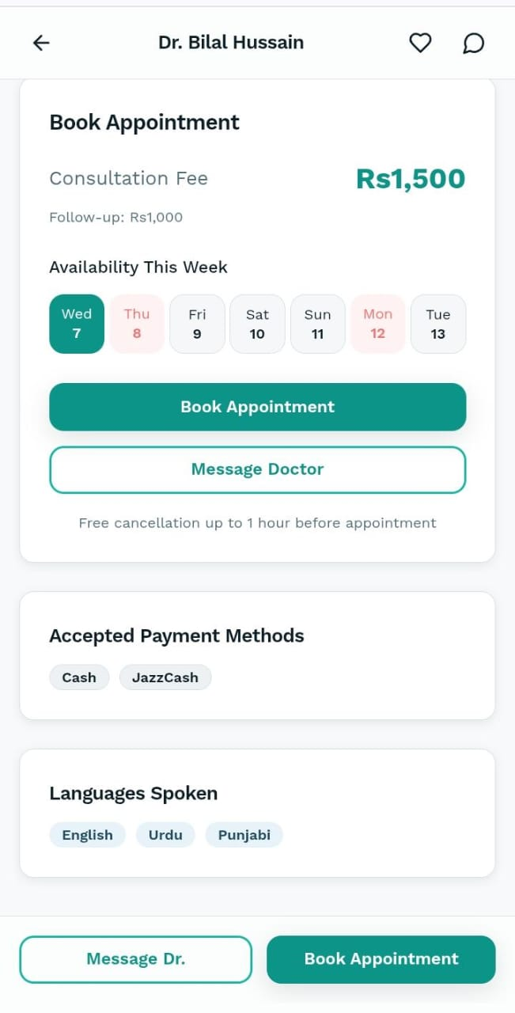
6. Book Appointment Page
Doctor's name displayed in header with back navigation, favorites, and chat icons
Consultation fee clearly shown
Weekly availability calendar showing dates
Available dates highlighted in teal, unavailable dates in light pink/gray
Two prominent action buttons: "Book Appointment" (primary) and "Message Doctor" (secondary)
Cancellation policy: Free cancellation up to 1 hour before appointment
Accepted payment methods: Cash and JazzCash
Languages spoken by doctor: English, Urdu, and Punjabi
Fixed bottom navigation with "Message Dr." and "Book Appointment" buttons for easy access

Slide 15
Technology Stack
Frontend
Backend
AI/ML
Database
React.js, Next.js, TypeScript
WebSocket for real-time updates
PWA for mobile experience
Node.js, Express.js
JWT Authentication, REST APIs
WebRTC for video calls
Python, TensorFlow/PyTorch
BERT for NLP, Google Vision OCR
Medical knowledge graphs
PostgreSQL, Redis
Google Cloud Platform
Docker containers

Slide 16
IMPLEMENTATION CHALLENGES & SOLUTIONS
Challenge 1
Solution
AI Accuracy in Medical Context
Confidence thresholding
Human escalation
Multi-model ensemble

Slide 17
IMPLEMENTATION CHALLENGES & SOLUTIONS
Challenge 2
Solution
Network Issues in Rural Pakistan
Adaptive bitrate streaming
Audio-only fallback
Offline capabilities

Slide 18
IMPLEMENTATION CHALLENGES & SOLUTIONS
Challenge 3
Solution
OCR Accuracy on Medical Reports
Image preprocessing
Manual correction interface
Confidence scoring

Slide 19
IMPLEMENTATION CHALLENGES & SOLUTIONS
Challenge 4
Solution
Payment Gateway Reliability
Adapter pattern
Retry mechanisms
Multiple provider support

Slide 20
SECURITY & PRIVACY MEASURES
Data Protection
Compliance
Security Features
End-to-end encryption for sensitive data
JWT authentication with refresh tokens
Role-Based Access Control (RBAC
Pakistan Medical Commission guidelines
Data privacy regulations compliance
Medical disclaimers and user consent
HTTPS-only communication
Input validation and sanitization
Comprehensive audit logging

Slide 21
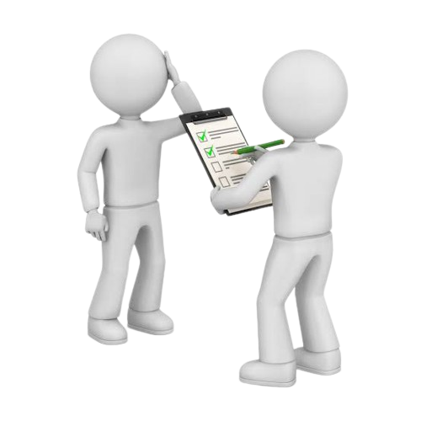
RESULTS & IMPACT : Expected Outcomes
1
Reduced healthcare access barriers in rural areas
2
Lower consultation costs for underserved populations
3
Improved health literacy through AI explanations
4
Time savings for both patients and doctors

Slide 22
TECHNICAL METRICS
95%
90%
95%
99%
AI response time: < 5 seconds (95% faster than traditional triage)
OCR accuracy: > 90% on standard reports
System availability: > 95%
Concurrent users supported: 1000+ (99% request success rate under peak load of 1,000+ concurrent users)

Slide 23
FUTURE ENHANCEMENTS
SHORT-TERM
Integration with wearable devices
Emergency services coordination
Prescription management
LONG-TERM
Chronic disease prediction models
Integration with hospital EHR systems
AI-powered diagnostic imaging analysis
Mental health support modules

Slide 24

CONCLUSIONS
For Patients
Provides accessible, affordable, and understandable healthcare guidance and consultations anytime, anywhere
For Doctors
Enables expanded reach and more efficient consultations, optimizing their time and practice.

Slide 25
CONCLUSIONS
For Society
Contributes to reduced healthcare disparities by bridging gaps in access and affordability.
This integrated platform represents a significant step toward democratizing quality healthcare in Pakistan, leveraging technology to create a more equitable and efficient ecosystem for all stakeholders.

Slide 26
THANK YOU !

